Slide 1
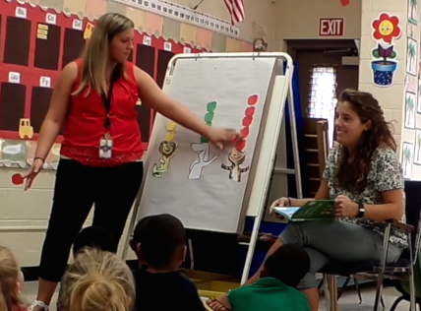
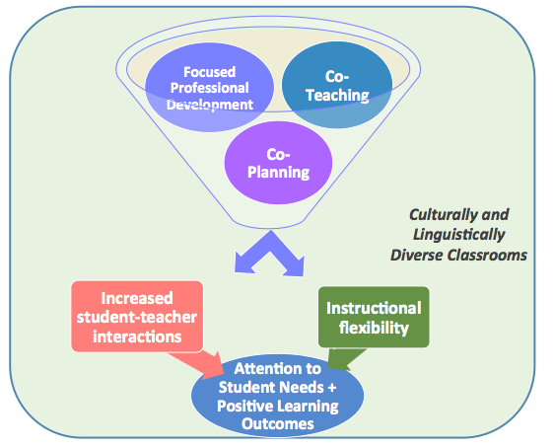
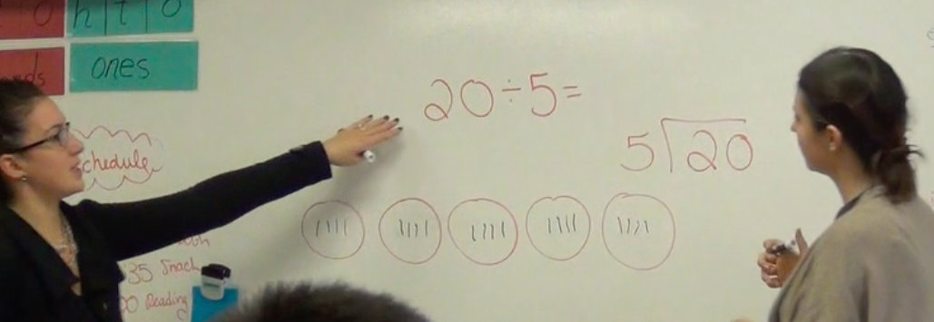
Voices of Co-teachers: Exploring Professional Possibilities in Culturally and Linguistically Diverse Elementary Classrooms
Mary P. Truxaw | mary.truxaw@uconn.edu Rebecca D. Eckert | rebecca.eckert@uconn.edu
ABSTRACT
This paper shares preliminary results from the first two years of an ongoing, small scale, professional development and research project that is implementing and investigating co-teaching practices in culturally and linguistically diverse elementary classrooms. Participants comprised co-teaching teams in classrooms where Spanish was the home language of many students, and included one veteran teacher and one master’s intern who had completed student teaching the year before. Results include a preliminary model for productive co-teaching in culturally and linguistically diverse classrooms. Also shared are co-teaching teams’ definitions for co-teaching, along with their perceptions of co-teaching overall and of specific co-teaching approaches (e.g., one teach, one observe; one teach, one assist; parallel teaching; station teaching; alternative (differentiated) teaching; team teaching). Implications for research and professional practice are shared.
CO-TEACHING APPROACHES WITH
BENEFITS NOTED BY CO-TEACHING TEAMS
TEACHERS’ PERCEPTIONS OF CO-TEACHING
RESEARCH QUESTIONS
What factors support productive co-teaching?
How do co-teaching teams define co-teaching?
How do co-teaching teams perceive their collaborative professional practice, including:
co-teaching overall
specific co-teaching approaches (e.g., one teach, one assist; one teach, one observe, parallel teaching, station teaching, alternative teaching, and team teaching)?
METHODS
OVERVIEW: 2 years of ongoing, small-scale study investigates how supported, co-teaching practices may enhance engagement with math discourse in linguistically diverse elementary school classrooms.
PARTICIPANTS: 7 co-teaching teams: one experienced teacher & one master’s intern (post-student teaching). Professional development (PD) and collaborative support in co-teaching and math discourse.
DATA: Interviews (audio & video recordings & transcriptions) and written reflections. The concept of cogenerative dialogue (Tobin & Roth, 2005) frames the ongoing qualitative analysis (Creswell, 1998).
RESULTS & DISCUSSION
This research documents voices of co-teachers, describing their collaborative practice in culturally and linguistically diverse classrooms. These voices, informed by qualitative data analysis, highlight the potential for co-teaching as a means of supporting the “dreams, possibilities, and necessity of public education” (AERA theme) that is responsive to the diverse learning needs of students and teachers.
The co-teachers’ definitions, along with each team’s perceptions of professional co-teaching practice, emphasize the three interacting factors (focused PD, co-planning, co-teaching practices) which must be considered when designing and implementing productive co-teaching experiences. In summary, co-teaching, when accompanied by focused PD and co-planning opportunities, have the potential to increase student-teacher interaction, instructional flexibility, and attention to student needs – and, thus, may promote positive student learning outcomes.
This work is significant because it has the potential to identify best practices, strategies, and tools to support teacher education and PD with specific emphasis on co-teaching in culturally and linguistically diverse classrooms.
CO-TEACHING DEFINITION (Friend & Cook, 2006)
Co-teaching is two (or more) educators who share instructional responsibility and mutually agreed-upon goals for a single group of students. The teachers have mutual ownership, pooled resources, and joint accountability, though individual teacher’s roles may vary.
COMPONENTS OF CO-TEACHERS’ DEFINITIONS
Collaboration & shared responsibility (Aligned with Friend & Cook, 2006)
Shared goals & expectations (Aligned with Friend & Cook, 2006)
Varied roles and approaches (Aligned with Friend & Cook, 2006)
Co-planning (not explicitly mentioned by Friend & Cook, 2006, but overlap with joint accountability)
Communication and reflection (not explicitly mentioned by Friend & Cook, 2006, but overlap with accountability)
Differentiation (not explicitly mentioned by Friend & Cook)
“People have this idea of what co-teaching looks like, but they don’t realize all the different ways – all the different models it can look [like]. It has to be what’s best for you …” ~KG, Gr. 2 Co-teacher~
“… co-teaching dynamics is really about how to engage with someone else because classrooms are kind of like a bedroom. It’s kind of our private space –public spaces for kids and teaching, but just think, at the end of the day, teachers become very protective of their own space. And I think that this [co-teaching] allows for practice in the area of engaging with another adult about best practices in the classroom with kids.” ~LB, Principal~
REFERENCES
Bacharach, N., Heck, T. W., & Dahlberg, K. (2010). Changing the face of student teaching through co-teaching. Action in Teacher Education, 32(1), 3-14.
Creswell, J. W. (1998). Qualitative inquiry and research design: Choosing among five traditions. Thousand Oaks, CA: Sage Publications.
Friend, M., & Cook, L. (2006). Interactions: Collaboration skills for school professionals (5th Ed.). Boston, MA: Allyn & Bacon.
Tobin, K., & Roth, W. M. (2005). Implementing coteaching and cogenerative dialoguing in urban science education. School Science and Mathematics, 105(6), 313-322.
ACKNOWLEDGMENTS: Neag School of Education, Dean’s Research Incentive Award & UConn Scholarship Facilitation Fund
Department of Curriculum and Instruction
249 Glenbrook Road, Unit 3033
education.uconn.edu
Storrs, CT 06269

